Slide 1
INTRODUCTION TO DATA STRUCTURES

Slide 2
INTRODUCTION
we saw that arrays had certain disadvantages as data storage structures. In an unordered array, searching is slow, whereas in an ordered array, insertion is slow. In both kinds of arrays deletion is slow. Also, the size of an array can’t be changed after it’s created (although it can be changed in a vector).
The linked list solves some of these problems. It performs better than arrays for insertion and deletion.
It can also be used to implement abstract data structures such as stacks and queues.
In a linked list data is stored in an object.

Slide 3

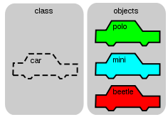
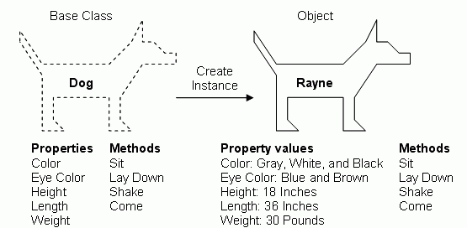
Review of objects
Linked lists make use of objects to store several pieces of information instead of arrays.
Recall to create an object:
1. First declare its properties by defining a class as follows
public class className
{
variable declaration;
function declaration;
}
2. Then create the object as follows:
ClassName ObjectName;
public class student
{
string sname;
void getname()
{
cout<<“Enter name”;
cin>>sname
}
};
Int main()
{
Student stud1;
Stud1.getname();
}

Slide 4

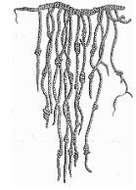
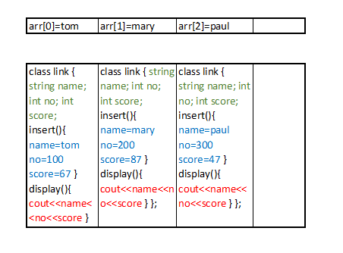
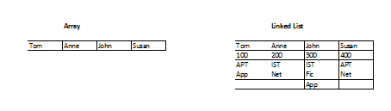
Arrays Linked lists

Slide 5
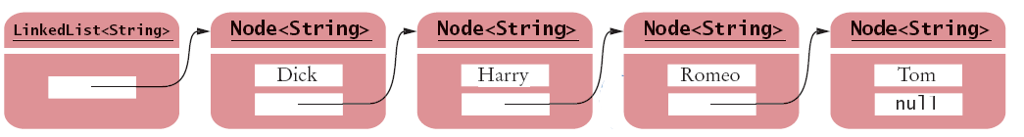
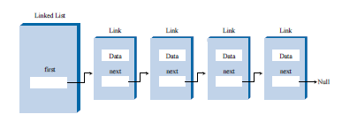
Since we have several objects that we need to manipulate we need to be able to find the location of the next object once we finish manipulating an object. We make use of pointers to do this. Thus each object needs to store its data as well as a pointer to the next object. That way the set of objects behaves as a chain with each object acting as a link to the next.
The object is therefore known as a link and the class of objects as the linked list. In addition to the data the link object stores the location of the next link using pointers.
class Link
{
public:
string item; //data item
double cost; //data item
Link* pNext; //pointer to next link
};

Slide 6
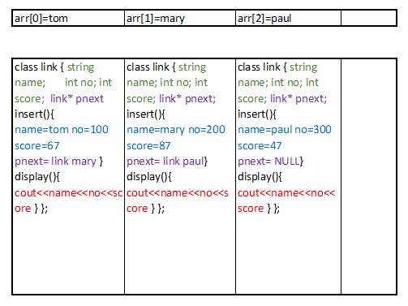
The idea of a link

Slide 7
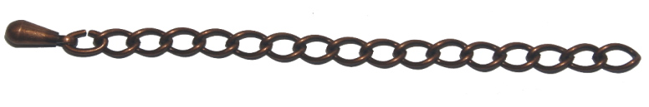
Implementing a Simple Linked List
Think of an object as a link and all the objects in the class as a group of links-linked list. Thus while the link contains data and the next link the linked list contains the links (that can be added or removed several times during the lifetime of a linked list).
The linked list also contains a special link that only contains the location of the first link. It is created when the linked list is created and destroyed when the linked list is destroyed.
While in an array each item can be directly accessed using an index number, in a list the only way to find a particular element is to follow along the chain of links. Our first example shows us how to insert from start, delete from start and display items on a linked list

Slide 8
class Link
{
public:
string item; //data item
double cost; //data item
Link* pNext; //ptr to next link in list
Link(string s, double c) //constructor
{
item=s;
cost=c;
pNext=NULL;
}
void displayLink()
{
cout << "{" << item << ", " << cost << "} ";
}
}; //end class Link

Slide 9
How do we join the links????

Slide 10
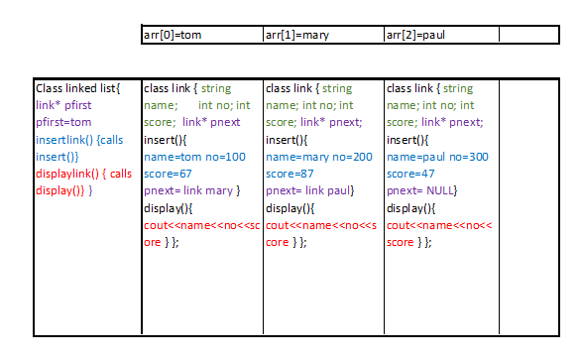
The idea of a linked list

Slide 11
Requirements
A class to describe a link – with the data and method to add and display the data(variables)
A class to describe a linked list-with the first link and method to add and display links(objects)
class LinkList
{
private:
Link* pFirst; //ptr to first link on list
public:
LinkList() //constructor
{
pFirst = NULL;
}
void insertFirst(string i, double c)
{}
void displayList()
{}
void removeFirst() //delete at first link
{ }
}; //end class Link

Slide 12
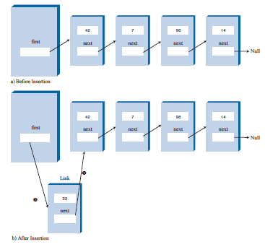
Inserting to linked list
Create a new link
Make new link next point at where first was pointing
Make first point at new link
void insertFirst(string i, double c)
{ //make new link
Link* pNewLink = new Link(i, c); //create
pNewLink->pNext = pFirst; //link points
pFirst = pNewLink; //first points
}

Slide 14
Display a linked list
2. Call display part of current
1. Name fist link current
void displayList()
{
cout << "List (first-->last): ";
Link* pCurrent = pFirst;
while(pCurrent != NULL) //until end of list,
{
pCurrent->displayLink(); //print data
pCurrent = pCurrent->pNext; //move to next link
}
cout << endl;
}
void displayLink()
{
cout << "{" << item << ", " << cost << "} ";
}
3. Make current be next link

Slide 15
Lets test our program!!!
Oh wait we need a main ☹…main creates objects but for which class?
Because class linked list is creating a link object …. then main will create a linked list object ☺

Slide 16
Main→linkedList→link ☺
int main()
{
LinkList theList; //make new list
theList.insertFirst("Milk", 50.00);
theList.insertFirst("Bread", 70.00);
theList.insertFirst("Sugar", 150.00);
theList.insertFirst("Salt", 10.00);
theList.displayList(); //display list
return 0;
} //end main()

Slide 17
#include<iostream>
#include<string>
using namespace std;
class Link
{
public:
string item; //data item
double cost; //data item
Link *pNext;
//ptr to next link in list
Link(string s, double c) //constructor
{ //to insert data
item=s;
cost=c;
pNext=NULL;
}
void displayLink()
{
cout << "{" << item << ", " << cost << "} ";
}
};
class LinkList
{
private:
Link* pFirst; //ptr to first link on list
public:
LinkList() //constructor
{
pFirst = NULL;
} //(no links on list yet)
//insert at start of list
void insertFirst(string i, double c)
{ //make new link
Link* pNewLink = new Link(i, c);
pNewLink->pNext = pFirst; //make pointer
pFirst = pNewLink;
}
void displayList()
{
cout << "List (first-->last): ";
Link* pCurrent = pFirst;
while(pCurrent != NULL) //until end of list,
{
pCurrent->displayLink(); //print data
pCurrent = pCurrent->pNext; //move
}
cout << endl;
}
}; //end class Link
int main()
{
LinkList theList; //make new list
theList.insertFirst("Milk", 50.00); theList.insertFirst("Bread", 70.00);
theList.insertFirst("Sugar", 150.00);
theList.insertFirst("Salt", 10.00);
theList.displayList(); //display list
return 0;
} //end main()
To create a link
Link* pNewLink = new Link(i, c);
To create a linked list
LinkList theList
To refer to item in link
pNewLink->pNext = pFirst;
pCurrent->displayLink();
To move from one link to the next
pCurrent = pCurrent->pNext;
To make a link equal to the other
pFirst = pNewLink;
Create a linked list that can be used to insert and display the numbers, names and scores for a quiz for 3 students.

Slide 18
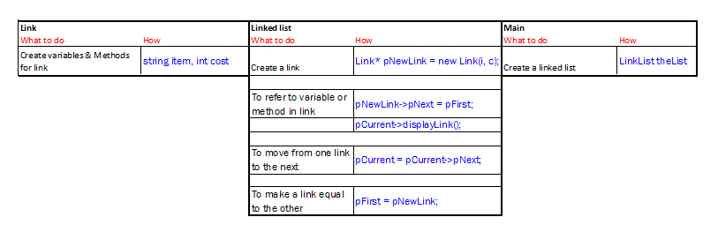

Slide 19
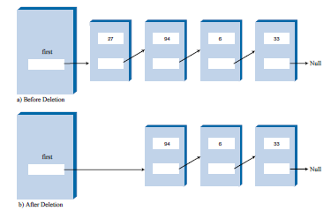
deleting from linked list
Make first point at the next
void removeFirst() //delete at first link
{ //(assumes list not empty)
pFirst = pFirst->pNext;
}

Slide 20
FILO→ STACK!!!

Slide 21
#include<iostream>
#include<string>
using namespace std;
class Link
{
public:
string item; //data item
double cost; //data item
Link* pNext; //ptr to next link in list
Link(string s, double c) //constructor
{
item=s;
cost=c;
pNext=NULL;
}
void displayLink()
{
cout << "{" << item << ", " << cost << "} ";
}
};
class LinkList
{
private:
Link* pFirst; //ptr to first link on list
public:
LinkList() //constructor
{
pFirst = NULL;
} //(no links on list yet)
void insertFirst(string i, double c)
{ //make new link
Link* pNewLink = new Link(i, c);
pNewLink->pNext = pFirst; //make pointer
pFirst = pNewLink;
}
void displayList()
{
cout << "List (first-->last): ";
Link* pCurrent = pFirst;
while(pCurrent != NULL) //until end of list,
{
pCurrent->displayLink(); //print data
pCurrent = pCurrent->pNext; //move
}
cout << endl;
}
void removeFirst() //delete at first link
{ //(assumes list not empty)
pFirst = pFirst->pNext;
}
}; //end class Link
int main()
{
LinkList theList; //make new list
theList.insertFirst("Milk", 50.00); theList.insertFirst("Bread", 70.00);
theList.insertFirst("Sugar", 150.00);
theList.insertFirst("Salt", 10.00);
theList.displayList(); //display list
theList.removeFirst(); //remove it
theList.displayList(); //display empty list
return 0;
} //end main()
To create a link
Link* pNewLink = new Link(i, c);
To create a linked list
LinkList theList
To refer to item in link
pNewLink->pNext = pFirst;
pCurrent->displayLink();
To move from one link to the next
pCurrent = pCurrent->pNext;
To make a link equal to the other
pFirst = pNewLink;

Slide 22
Exercise:
Suppose cursor points to a node in a linked list (using the node definition with member functions called data and link). What statement changes cursor so that it points to the next node?
A. cursor++;
B. cursor = link;
C. cursor->link =cursor;
D. cursor = cursor->link;
Suppose cursor points to a node in a linked list (using the node definition with member functions called data and link). What Boolean expression will be true when cursor points to the tail node of the list?
A. (cursor == NULL)
B. (cursor->link == NULL)
C. (cursor->data == NULL)
D. (cursor->data == 0.0)
E. None of the above

Slide 23
Finding a Specified Links
Create a current link and make it have contents of first link
Compare current data with key
If not equal move - make current equal to next
int find(string key) //find link with given key
{ //(assumes non-empty list)
Link* pCurrent = pFirst; //start at ‘first’
while(pCurrent->item != key) //while no match,
{if(pCurrent->pNext == NULL) //if end of list,
{cout<<"Not Found"<<endl;
return 0;
}
else //not end of list,
{pCurrent = pCurrent->pNext; //go to next link
}}
cout<<"Found "<<key<<endl;
return 0; //found it
}
Exercise: Add this function to your program
Modify method insert to insert a specified link
Notes:
int displayList()
{
string key;
cout<<"enter key to search for: ";
cin>>key;
Link* pCurrent = pFirst;
while(pCurrent != NULL) //until end of list,
{
if(pCurrent->item==key)
{
cout<<"Found";
return 0;
}
pCurrent = pCurrent->pNext; //move
}
cout << "not found";
return 0;
}

Slide 24
Exercises:
write a function that can be used to get the total of all items on a linked list
write a function that can be used to display any items on the linked list that cost more than 50.00

Slide 25
Write a program that can be used to implement the following functions:
Delete specified link

Slide 26
Remove a specified link
Create a link and make it point at first
Compare data with key
If not equal move-make current equal to next
If equal delete by ignoring current
int remove(string key) //delete at first link
{ //(assumes list not empty)
Link* pCurrent = pFirst; //start at ‘first’
Link* pPrevious = pFirst;
while(pCurrent->item != key) //while no match,
{
if(pCurrent->pNext == NULL) //if end of list,
{ cout<<"Not Found"<<endl;
return 0;
}
else //not end of list,
{
pPrevious = pCurrent; //update previous
pCurrent = pCurrent->pNext; //go to next link
}}//end while
//if match...we delete
if(pCurrent == pFirst) //if first link,
pFirst = pFirst->pNext; //change first to next hence ignoring first
else //otherwise,
pPrevious->pNext = pCurrent->pNext; //change previous to next hence ignoring current
delete pCurrent; //link is still in memory, this code deletes link
cout<<“Deleted "<<key<<endl;
return 0; //found it
}
Notes:
int removeList()
{
string key;
cout<<"enter key to delete: ";
cin>>key;
Link* pCurrent = pFirst;
Link* pPrev = pFirst;
while(pCurrent != NULL) //until end of list,
{
if(pCurrent->item==key)
{
cout<<"Found....Deleting....: ";
if(pCurrent==pFirst)
{
pFirst=pFirst->pNext;
}
else
{pPrev->pNext=pCurrent->pNext;
}
return 0;
}
pPrev=pCurrent;
pCurrent = pCurrent->pNext; //move
}
cout << "not found";
return 0;
}

Slide 27
The Efficiency of Linked Lists
Insertion and deletion at the beginning of a linked list are very fast. They involve changing only one or two pointers, which takes O(1) time.
Finding or deleting a specified item requires searching through, on the average, half the items in the list. This requires O(N) comparisons. An array is also O(N) for these operations, but the linked list is nevertheless faster because nothing needs to be moved when an item is inserted or removed.
The linked list uses only as much memory as it needs, and can expand to fill all available memory. The size of an array is fixed when it’s created; this usually leads to inefficiency if the declared space is too large, or too small. Vectors, which are expandable arrays, might solve this problem to some extent, but they usually expand in fixed-sized increments (such as doubling the size of the array whenever it’s about to overflow). This use of memory is still not as efficient as a linked list.

Slide 28
Avoiding Memory Leaks
To create a linked list, the program creates a list of object. When a program terminates the Link objects that have been created will remain in memory unless we take steps to delete them.
A destructor is a special member function of a class that is executed whenever a program terminates or the keyword delete is applied to a pointer to the object of that class.
A destructor will have exact same name as the class prefixed with a tilde (~) and it can neither return a value nor can it take any parameters. Destructor can be very useful for releasing resources before coming out of the program like closing files, releasing memories etc.

Slide 29
We can modify our linked list program as illustrated next to avoid memory leaks
Add a destructor in class LinkedList
~LinkList() //destructor (deletes links)
{
Link* pCurrent = pFirst; //start at beginning of list
while(pCurrent != NULL) //until end of list,
{
Link* pOldCur = pCurrent; //save current link
pCurrent = pCurrent->pNext; //move to next link
delete pOldCur; //delete old current
}
}

Slide 30
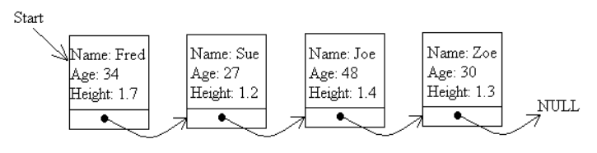
CLASS exercises
Write a program that can be used to implement the linked list below. It should be able to insert, search, and display records.
Write a function that can be used to find the average age of all the elements. Ensure that the function can work even when more records are added to the linked list
Write a function that can be used to remove any erroneous elements from the linked list. These are elements that have a height above 3M and below 0.3M.
Write a function that can be used to display any duplicate elements from the linked list. These are elements whose names are repeated. Test the code by adding duplicate entries.
Write a function that can be used to remove any duplicate elements from the linked list leaving only one entry. Test the code by adding duplicate entries.

Slide 31
Sorted Lists
Just like ordered arrays with data arranged in a certain manner, we can also have sorted lists. In general you can use a sorted list in most situations where you use a sorted array.
The advantages of a sorted list over a sorted array are:
speed of insertion (because elements don’t need to be moved)
a list can expand to fill available memory, whereas an array is limited to a fixed size.
However, as a disadvantage, a sorted list is somewhat more difficult to implement than a sorted array.

Slide 32
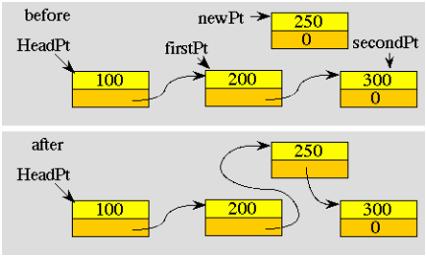
Inserting into sorted list
Like an array we need to:
Find the correct spot (where next is larger)
Change the previous link to point the newlink
Make newlink to point at the current
void insert(string i, double c) //insert, in order
{
Link* pNewLink = new Link(i,c); //make new link
Link* pPrevious = NULL; //have a pointer to the previous link
Link* pCurrent = pFirst; //start at first
//until end of list,
while(pCurrent != NULL && i > pCurrent->item)//if not correct spot
{
pPrevious = pCurrent; //remember previous link
pCurrent = pCurrent->pNext; //go to next item
}
if(pPrevious==NULL) //if at beginning of list
pFirst = pNewLink; //insert newLink at pFirst
else //mid correct spot
pPrevious->pNext = pNewLink; //make previous point newLink
pNewLink->pNext = pCurrent; //make newLink point current
} //end insert()
Notes:
int orderedinsert(string x, double y)
{
link* pcurrent=pfirst;
link* pprev=NULL;
link* pnewlink=new link(x,y);
while(pcurrent!=NULL && pcurrent->item<x)
{
pprev=pcurrent;
pcurrent=pcurrent->pnext; //move/increment
}
if(pprev==NULL) //if at beginning of list
pfirst = pnewlink; //insert newLink at pFirst
else
pprev->pnext=pnewlink;
pnewlink->pnext=pcurrent;
}

Slide 33
Bubble sort
void bubblesort()
{int i,j;
for( i = 0; i < 8; i++ )
{link * pcurrent = pfirst;
link * pafter = pfirst->pnext;
for( j = 0; j < 8-i; j++ )
{if( pcurrent->age > pafter->age )
{int tempage = pcurrent->age;
double tempheight = pcurrent->height;
string tempname = pcurrent->name;
pcurrent->age=pafter->age;
pcurrent->height=pafter->height;
pcurrent->name=pafter->name;
pafter->age=tempage;
pafter->height=tempheight;
pafter->name=tempname;
}pcurrent = pafter;
pafter = pafter->pnext;
}}}
Notes:
#include <iostream>
using namespace std;
class link
{
public:
int age;
string name;
double height;
link *pnext;
link(string x, int y, double z){
name=x;
age=y;
height=z;
pnext=NULL;
}
void display(){
cout<<"Name = "<<name<<" "<<"Age = "<<age<<" "<<"Height = "<<height<<endl;
}
};
class linkedlist
{
private:
link * pfirst;
link * plast;
public:
linkedlist()
{
pfirst = NULL;
plast = NULL;
}
void insertlist(string x, int y, double z){
link* pnewlink = new link(x,y,z); //call insert for class link
pnewlink->pnext=pfirst; //point to next link
pfirst=pnewlink; //make pfirst point to new link
}
void displaylist(){
link* pcurrent;
pcurrent=pfirst;
while(pcurrent!=NULL){
pcurrent->display();
pcurrent=pcurrent->pnext; //moves to next link
}
}
void bubblesort()
{
int i,j;
for( i = 0; i < 8; i++ )
{
link * pcurrent = pfirst;
link * pafter = pfirst->pnext;
for( j = 0; j < 8-i; j++ )
{
if( pcurrent->age > pafter->age )
{
int tempage = pcurrent->age;
double tempheight = pcurrent->height;
string tempname = pcurrent->name;
pcurrent->age=pafter->age;
pcurrent->height=pafter->height;
pcurrent->name=pafter->name;
pafter->age=tempage;
pafter->height=tempheight;
pafter->name=tempname;
}
pcurrent = pafter;
pafter = pafter->pnext;
}
}
}
};
int main()
{
linkedlist w;
w.insertlist("Kevin", 21, 1.50);
w.insertlist("Victor", 20, 1.70);
w.insertlist("Dancy", 19, 1.45);
w.insertlist("Hope", 23, 1.55);
w.insertlist("Anne", 29, 1.60);
w.insertlist("John", 25, 1.80);
w.insertlist("Peter", 18, 1.65);
w.insertlist("Mark", 27, 1.35);
w.insertlist("Brian", 30, 1.30);
w.displaylist();
w.bubblesort();
cout<<endl;
w.displaylist();
return 0;
}

Slide 34
Insertion sort
Exercise: Implement an insertion sort algorithm.

Slide 35
Insertion sort
void insertionSort()
{
linked *in, *out;
for(out=pfirst->pnext; out!=NULL; out=out->pnext)
{
string tempi = out->item; //store right element in temp
double tempc = out->cost;
in=out;
while(in->previous!=NULL && in->previous->item>=tempi) //do to last left and if out of order,
{
in->item = in->previous->item; //swap
in->cost = in->previous->cost; //swap
in=in->previous;
}
in->item=tempi;
in->cost=tempc;
}
}
Notes:
#include <iostream>
using namespace std;
class linked{
public:
string item;
double cost;
linked* pnext;
linked* previous;
linked(string i,double c)
{
item=i;
cost=c;
pnext=NULL;
previous=NULL;
}
void display()
{
cout<<item<<"\t"<<cost<<endl;
cout<<endl;
}
};
class linkedlist{
private:
linked* pfirst;
linked* plast;
public:
linkedlist()
{
pfirst=NULL;
plast=NULL;
}
void insertlist(string a, double b)
{
linked* pnewlink=new linked(a, b); //call insert for class link
pnewlink->pnext=pfirst; //point at next link
pfirst=pnewlink; //make pfirst point at new link
}
void displaylist()
{
linked* pcurrent;
pcurrent=pfirst;
while(pcurrent!=NULL)
{
pcurrent->display();
pcurrent=pcurrent->pnext;
}
//pfirst->display();
}
void insertFirst(string i, double c)
{ //make new link
linked* pNewLink = new linked(i, c); //create link
if( pfirst==NULL ) //if empty list,
{
plast = pNewLink; //make pLast point at new link
}
else
{
pfirst->previous = pNewLink; //make previous point at new
}
pNewLink->pnext = pfirst;
pfirst = pNewLink;
}
void insertionSort()
{
linked *in, *out;
for(out=pfirst->pnext; out!=NULL; out=out->pnext)
{
string tempi = out->item; //store right element in temp
double tempc = out->cost;
in=out;
while(in->previous!=NULL && in->previous->item>=tempi) //do to last left and if out of order,
{
in->item = in->previous->item; //swap
in->cost = in->previous->cost; //swap
in=in->previous;
}
in->item=tempi;
in->cost=tempc;
}
}
};
int main()
{
linkedlist x;
x.insertFirst("Bread", 50.00);
x.insertFirst("Salt", 650.00);
x.insertFirst("Milk", 70.00);
x.insertFirst("Sugar", 45.00);
x.insertFirst("Delta", 100.00);
x.displaylist();
x.insertionSort();
x.displaylist();
return 0;
}

Slide 36
A Stack Implemented By a Linked List
An abstract data type (ADT) is a way of looking at a data structure: focusing on what it does, and ignoring how it does it. Because of this we saw that we can have a data structure that manipulates data in a FIFO (Queues) or FILO (Stacks) implemented using an array.
Similar such data structures can also be implemented with a linked list. All we have to do is ensure that data is accessed from one end only (stacks) or two ends (queues)
To use a linked list to implement a stack simply calls for the push() and pop() operations being done as follows:
theList.insertFirst(data) and data = theList.deleteFirst()
The user of the stack class calls push() and pop() to insert and delete items, without knowing, or needing to know, whether the stack is implemented as an array or as a linked list.
Exercise: Rename the insertFirst() and deleteFirst() methods to push() and pop()

Slide 37
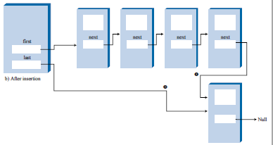
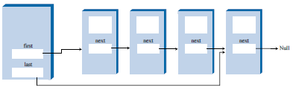
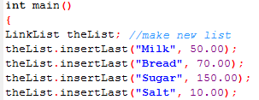


Implementing a Queue Using a Linked List
To implement a queue we need a linked list that can be accessed from both ends. Such a list is known as a double-ended list. Of course you can insert a new link at the end of an ordinary single-ended list by iterating through the entire list until you reach the end, but this is very inefficient.
A double-ended list is similar to an ordinary linked list, but it has one additional feature: a reference to the last link as well as to the first: Link* pLast;
Finally add a method insertlast() to replace insertfirst() and retain remove first
void insertLast(string I , double c) //insert at end of list
{
Link* pNewLink = new Link(I , c); //make new link
if( pFirst==NULL) //if empty list,
pFirst = pNewLink; //first --> newLink
else
pLast->pNext = pNewLink; //old last --> newLink
pLast = pNewLink; //newLink <-- last
}
Remember to change the method that you call in your main from insertfirst() to insertlast()
Expected Output: A Stack A Queue
Notes:
int insertlast(string n,double c)
{
link* x;
x=pfirst;
link* pnewlink=new link(n,c);
if(pfirst==NULL)
{
pfirst=pnewlink;
return 0;
}
while(x->pnext!=NULL)
{
x=x->pnext;
}
x->pnext=pnewlink;
pnewlink=NULL;
return 0;
}
________________________________________________________________________________________
int insertlastdirect(string n,double c)
{
link* pnewlink=new link(n,c);
if(pfirst==NULL)
{
pfirst=pnewlink;
plast = pnewlink;
return 0;
}
plast->pnext = pnewlink;
plast = pnewlink;
return 0;
}

Slide 38
Summary:
Stack Functions - InsertFirst(), Display(), RemoveFirst(),Find()
Queue Functions - InsertLast(), Display(), RemoveFirst(),Find()
Note that class link remains the same in both cases.
first
93
48
17
142
head
first
48
17
142
//
93
//
Notes:
#include <iostream>
using namespace std;
class link
{
public:
string iname;
double icost;
link* pnext;
public:
link(string n,double c)
{
iname=n;
icost=c;
pnext=NULL;
}
void display()
{
cout<<"Name : "<<iname<<" Cost :"<<icost<<endl;
}
};
class linkedlist
{
private:
link* pfirst;
public:
linkedlist()
{
pfirst=NULL;
}
void insert(string name,double cost)
{
link* pnewlink=new link(name,cost);
pnewlink->pnext=pfirst;
pfirst=pnewlink;
}
void displaylist()
{link* x;
x=pfirst;
while(x!=NULL)
{x->display();
x=x->pnext;
}
}
void mydelete()
{
pfirst=pfirst->pnext;
}
int search()
{string r;
cout<<"Enter Item name to search for";
cin>>r;
link* x;
x=pfirst;
while(x!=NULL)
{
if(r==x->iname)
{cout<<"Found!";
return 0;
}
x=x->pnext;
}
cout<<"Not Found!";
return 0;
}
int removespecific()
{
string r;
cout<<"Enter Item name to search for";
cin>>r;
link* x;
link* prev;
x=pfirst;
prev=pfirst;
while(x!=NULL)
{
if(r==x->iname)
{cout<<"Found!";
if(r==pfirst->iname)
pfirst=pfirst->pnext;
else
prev->pnext=x->pnext;
return 0;
}
prev=x;
x=x->pnext;
}
cout<<"Not Found!";
return 0;
}
int oinsert(string n,double c)
{
link* pnewlink=new link(n,c);
pnewlink->pnext=pfirst;
if(pfirst==NULL)
{
cout<<"Test1"<<n<<endl;
pfirst=pnewlink;
return 0;
}
link* x;
link* prev;
x=pfirst;
prev=pfirst;
cout<<"Test2"<<n<<" "<<x->iname<<endl;
while(x != NULL && n > x->iname)//if not correct spot
{
prev=x;
x=x->pnext;
}
cout<<"Test4"<<pnewlink->iname<<" "<<prev->iname<<endl;
prev->pnext=pnewlink;
pnewlink->pnext=x;
return 0;
}
int insertlast(string n,double c)
{
link* x;
x=pfirst;
link* pnewlink=new link(n,c);
if(pfirst==NULL)
{
pfirst=pnewlink;
return 0;
}
while(x->pnext!=NULL)
{
x=x->pnext;
}
x->pnext=pnewlink;
pnewlink=NULL;
return 0;
}
};
int main() {
linkedlist mylist;
mylist.insert("Milk", 30.00);
mylist.insert("Bread", 60.00);
mylist.insert("Sugar", 50.00);
mylist.insert("Salt", 40.00);
mylist.displaylist();
// mylist.removespecific();
// mylist.displaylist();
// mylist.search();
return 0;
}

Slide 39
A linked list that is used to implement a queue is sometimes referred to as a double ended list
Exercise:
Write a program that accepts the employee number of a new employee and prints the employee tag with the number in the order of first come first served.
Modify the program to also print the employee to retrench in the order of first In last Out.

Slide 40
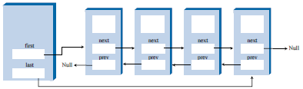
Doubly Linked Lists
The lists we have looked at so far only allow us to move forward. This is because they only have a pointer to the next link.
A doubly linked list has a pointer to the next link as well as a pointer to the previous. This enables you to move forward as well as backward. Don’t confuse this with a double ended list which is a list that enables you to implement a queue.

Slide 41
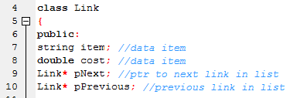

Note:
The introduction of a pointer to previous in a link
The introduction of a pointer to the last in a linked list

Slide 42
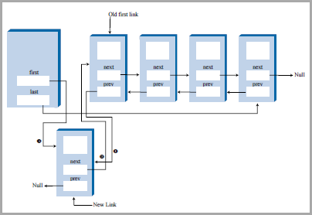
Inserting into a doubly linked list
For simplicity we can look at inserting at the beginning only. While we will do everything we did when inserting first for a stack i.e.
Create a new link
Make new link next point at where first was pointing
Make first point at new link
We need to add a few things to that. We will adjust the previous pointer in addition to the next pointer. We also need to remember to assign the pLast pointer.
void insertFirst(string i, double c)
{ //make new link
Link* pNewLink = new Link(i, c); //create
pNewLink->pNext = pFirst; //link points
pFirst = pNewLink; //first points
}

Slide 43
Inserting into a doubly linked list
For simplicity we can look at inserting at the beginning only. While we will do everything we did when inserting first for a stack i.e.
Create a new link
Make new link next point at where first was pointing
Make first point at new link
We need to add a few things to that. We will adjust the previous pointer in addition to the next pointer. We also need to remember to assign the pLast pointer.
void insertFirst(string i, double c)
{ //make new link
Link* pNewLink = new Link(i, c); //create link
if( pFirst==NULL ) //if empty list,
{
pLast = pNewLink; //make pLast point at new link
}
else
{
pFirst->pPrev = pNewLink; //make previous point at new
}
pNewLink->pNext = pFirst;
pFirst = pNewLink;
}}
void insertFirst(string i, double c)
{ //make new link
Link* pNewLink = new Link(i, c); //create
pNewLink->pNext = pFirst; //link points
pFirst = pNewLink; //first points
}

Slide 44
Displaying backwards
This is very similar to displaying forward with the following differences:
You start at the end (pLast) instead of the beginning (pFirst)
You move to the previous instead of the next
You stop when you reach the first node.

Slide 45
Displaying backwards
This is very similar to displaying forward with the following differences:
You start at the end (pLast) instead of the beginning (pFirst)
You move to the previous instead of the next
You stop when you reach the first node.
void displayBackward()
{cout << "List (last-->first): ";
Link* pCurrent = pLast; //start at end
while(pCurrent != pFirst)
{
pCurrent->displayLink(); //display data
pCurrent = pCurrent->pPrevious; //go to previous link
}
pCurrent->displayLink(); //display pFirst
cout << endl;
}
void displayList()
{
cout << "List (first-->last): ";
Link* pCurrent = pFirst;
while(pCurrent != NULL) //until end of list,
{
pCurrent->displayLink(); //print data
pCurrent = pCurrent->pNext; //move
}
cout << endl;
}

Slide 46
● Insertion in a sorted list takes O(N) time because the correct insertion point must be found.
Deletion of the smallest link takes O(1) time.

Slide 47
Exercises: Create a linked list that can be used to store a students name and the scores of two quizes.
Write a method that can be used to insert five records that a user keys in into a stack and a method that can be used to pop and peek them. The peek method should also be able to display the total of the quizzes. The total should not be stored in the linked list.
Write a method that can be used to insert five records into a queue and a method that can be used to deQueue them.
Modify the push method to insert records in a sorted manner into the linked list.

